Slide 1
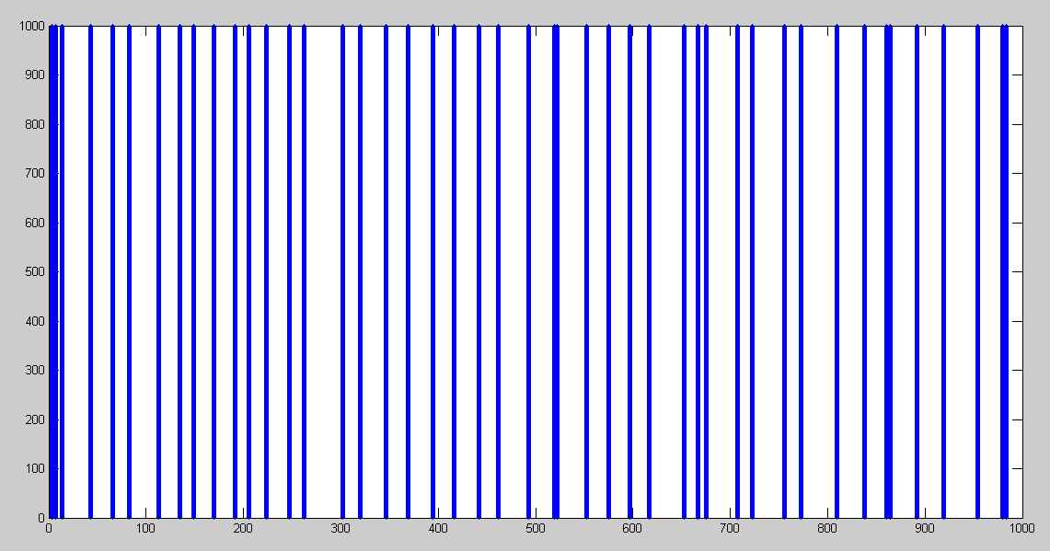

Slide 2
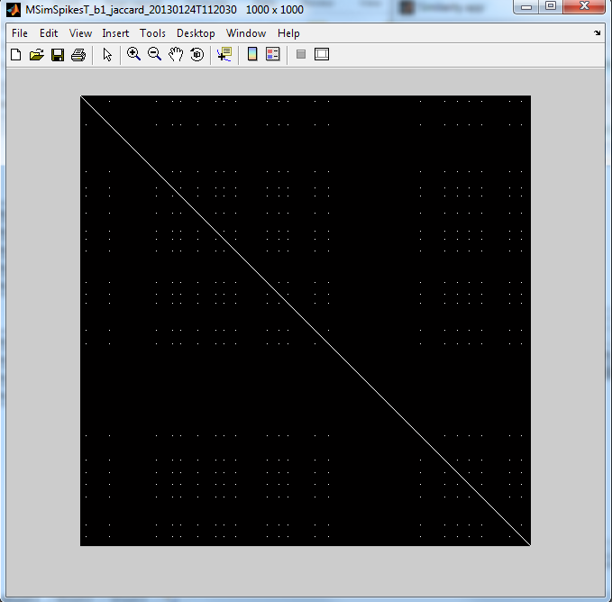

Slide 4
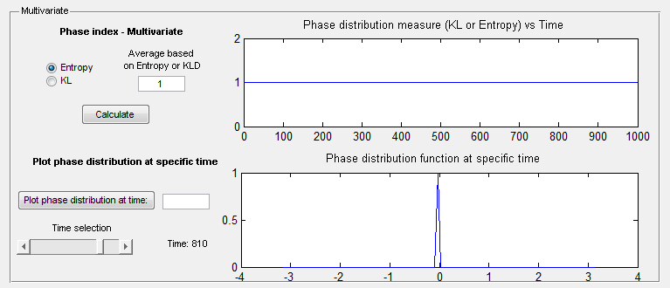
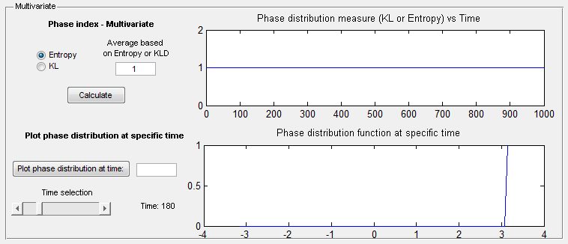
VV
Phase multivariate entropy of phase distribution

Slide 5
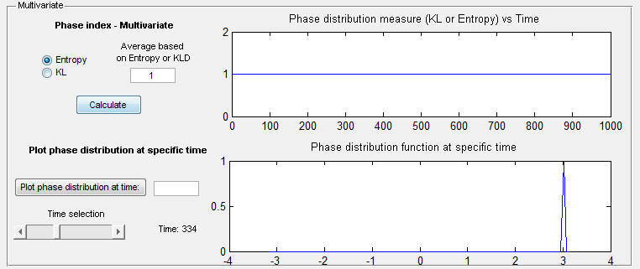
VV
Phase multivariate entropy of phase distribution
BUENA

Slide 6
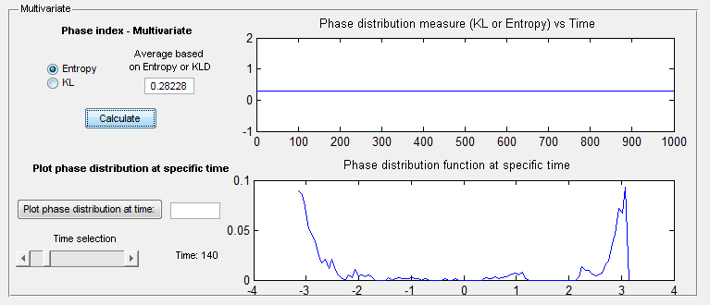
VV Transposed
Phase multivariate entropy of phase distribution

Slide 7
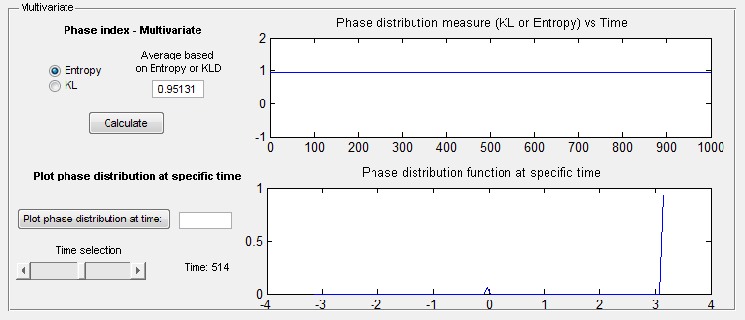
VV Transposed
Phase multivariate entropy of phase distribution
BUENA

